Slide 1



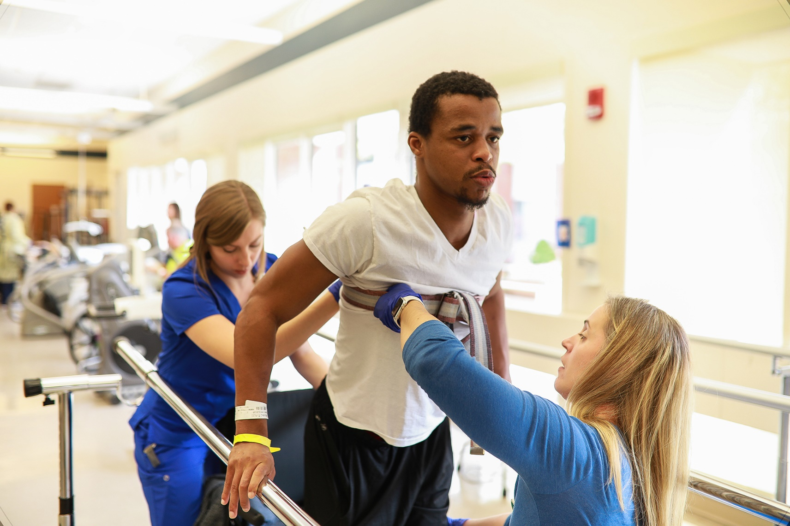

Gaylord Specialty Healthcare’s Dedicated
WORKERS’ COMPENSATION TEAM
Gaylord Specialty Healthcare
Comprehensive
Injured Worker Program
Among the best in the country at helping injured workers
recover and return to their highest quality of life.
Making the Workers’ Compensation Process Easy and Efficient
To Make an
Outpatient Referral:
Dedicated
Workers’ Compensation Physician:
Medical Director,
Outpatient and Workers’
Compensation Services
Jerrold L. Kaplan, MD
(203) 284-2845
jkaplan@gaylord.org
Workers’ Comp. Liaison
Jaclyn Magnuszewski, COTA
(203) 284-2989
jmagnuszewski@gaylord.org
To Establish a
Contract or Single Case Agreement:
To Make an
Inpatient Referral:
Manager of Payer Relations
Kathryn Prevost, RN
(203) 294-3279
kprevost@gaylord.org
Workers’ Comp. Liaison
Elizabeth Weber, RN, BSN
(860) 426-5973
eweber@gaylord.org
Hospital and Outpatient Services
50 Gaylord Farm Road, Wallingford, CT
Physical Therapy - Cheshire
1154 Highland Avenue , Cheshire, CT
Physical Therapy - Cromwell
50 Berlin Road, Cromwell, CT
Physical Therapy - Madison
28 Durham Road, Durham, CT
Physical Therapy and Neuro Rehabilitation - North Haven
8 Devine Street, North Haven, CT
gaylord.org

Slide 2
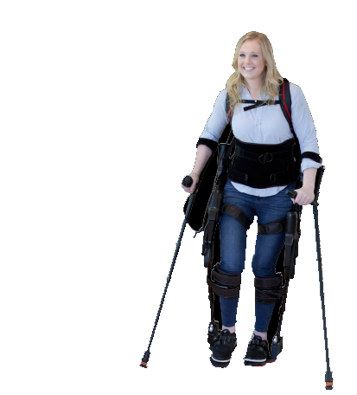





Outpatient: Specializing In Treating Injured Workers
All Inclusive
Recovery for Injured Workers
From simple to catastrophic care, our record for restoring function and returning people to work
demonstrates our decades of experience and superior care.
We provide the injured worker with the latest evidence-based rehabilitation while supporting
and educating family members in a healing environment.
Expertise in addressing work capacity concerns and
facilitating return-to-work planning.
We focus on improving movement, mobility and strength to restore, maintain and promote optimal physical function.
5 Convenient Oupatient Locations
Large Indoor Therapy Pool
Neuropsychology Program
Physiatry Services
Aphasia & Cognitive Day Therapy Program
Bionic Exoskeletons - Ekso™ & ReWalk™
Comprehensive Center for Concussion Care
PT, OT, Speech and Aquatic Therapy
Vestibular Therapy
Vision Therapy
Well respected 137-Bed Inpatient Long-Term Acute Care Hospital
5 Location Outpatient Therapy Program
Dedicated Workers’ Compensation Team
In-House Neuropsychology Department
Comprehensive Concussion Program
CARF Accreditation in Spinal Cord Injury, Stroke & Brain Injury Rehabilitation Programs - both Inpatient & Outpatient
Guest Housing For Overnight Visitors/Family
Large Indoor Therapy Pool – Inpatient & Outpatient
Support Groups For Patients & Caregivers
High Level Care = Better Outcomes
Percentage of Patients
with No Post-Discharge
Hospitalizations
Gaylord Patients are
Able to Return to their
Homes & Lives
Inpatient: The Perfect
Environment To Heal
All Private Inpatient Rooms
Located on 400+ Scenic Acres
4,500 Sq. Ft. State-Of-The-Art Rehab Gym
Assistive Technology Program
Home Simulation Area
Largest Adaptive Sports Program in the Region
Cutting Edge Rehab Technology
Neuro Program
100%
94.6%
Had NO Post-Discharge
Hospitalizations
Percentage of Workers’ Comp Inpatients
Discharged Back to the Community,
FY2022 Gaylord Data
IT Health Track Data 4/1/2020 - 3/31/2021
Gaylord Inpatients, 90 Day Follow-up

