Slide 1

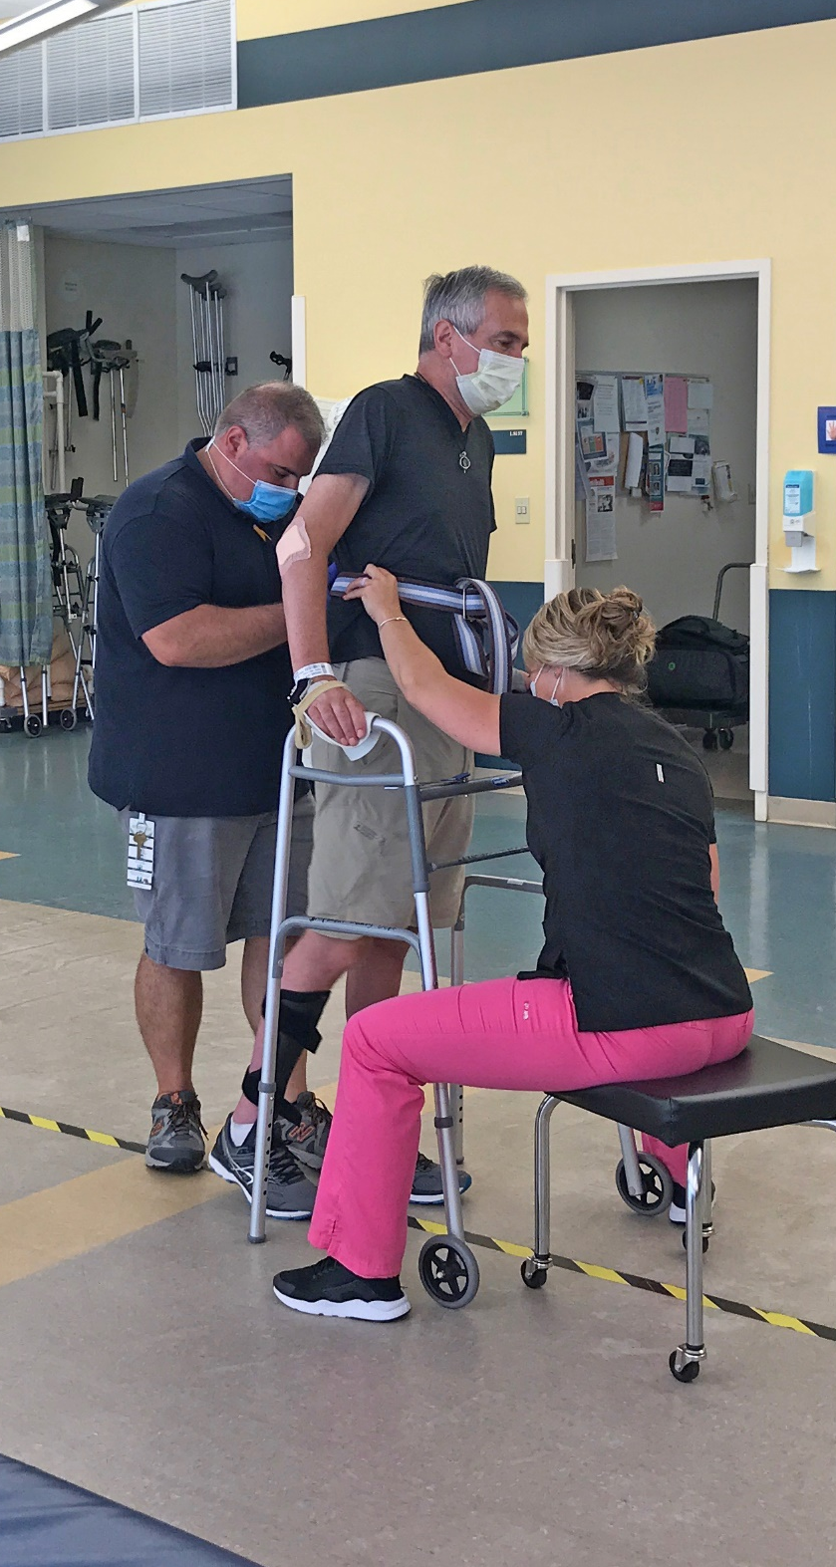


BIG PROGRESS!
John D. Hopkins
DOB: 8/25/1969 (54 years old)
Yale New Haven Hospital
Gaylord Admit Date: 4/10/2023
Gaylord Discharge Date: 5/24/2023
Physical Therapy Notes (5/23/23):
John has made good progress this week
meeting all short-term goals
Progressed significantly with improved tolerance to therapy
Now at a distant supervision level
for bed mobility, transfers and ambulation
Now at a supervision level for stairs
Occupational Therapy Notes (5/23/23):
Improved tolerance to therapies and continues to progress toward OT goals
Wound vac discharged on 5/18/23 – now able to mobilize with increased ease
Wound Care Note (5/24/23):
Wounds continue to improve
Dressing change can be decreased to once a day
Supplies have been provided
Pictured:
John is pictured here in a co-treat rehab session with his occupational therapist, BJ Palumbo and his physical therapist, Caitlin Boland.
50 Gaylord Farm Road
Wallingford, CT 06492
www.Gaylord.org

